Slide 1
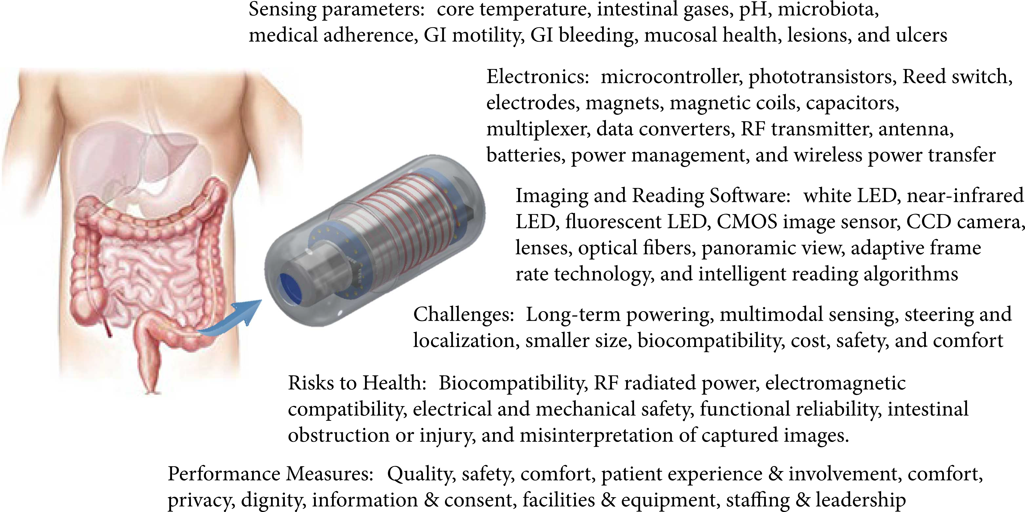
Title: Video Capsule Endoscopy and Ingestible Electronics: Emerging Trends in Sensors, Circuits, Materials, Telemetry, Optics, and Rapid Reading Software
Advanced Devices & Instrumentation, Volume 2021 |Article ID 9854040
https://doi.org/10.34133/2021/9854040
Dylan Miley, Leonardo Bertoncello Machado, Calvin Condo, Albert E. Jergens, Kyoung-Jin Yoon, and Santosh Pandey

Slide 2
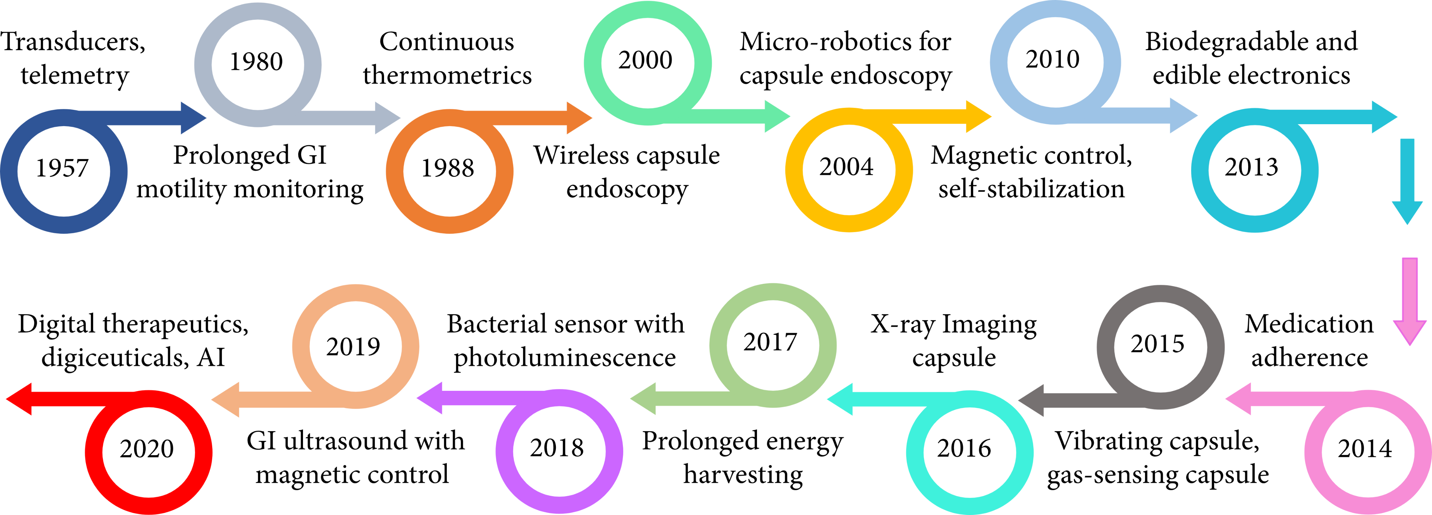
Title: Video Capsule Endoscopy and Ingestible Electronics: Emerging Trends in Sensors, Circuits, Materials, Telemetry, Optics, and Rapid Reading Software
Advanced Devices & Instrumentation, Volume 2021 |Article ID 9854040
https://doi.org/10.34133/2021/9854040
Dylan Miley, Leonardo Bertoncello Machado, Calvin Condo, Albert E. Jergens, Kyoung-Jin Yoon, and Santosh Pandey

Slide 3
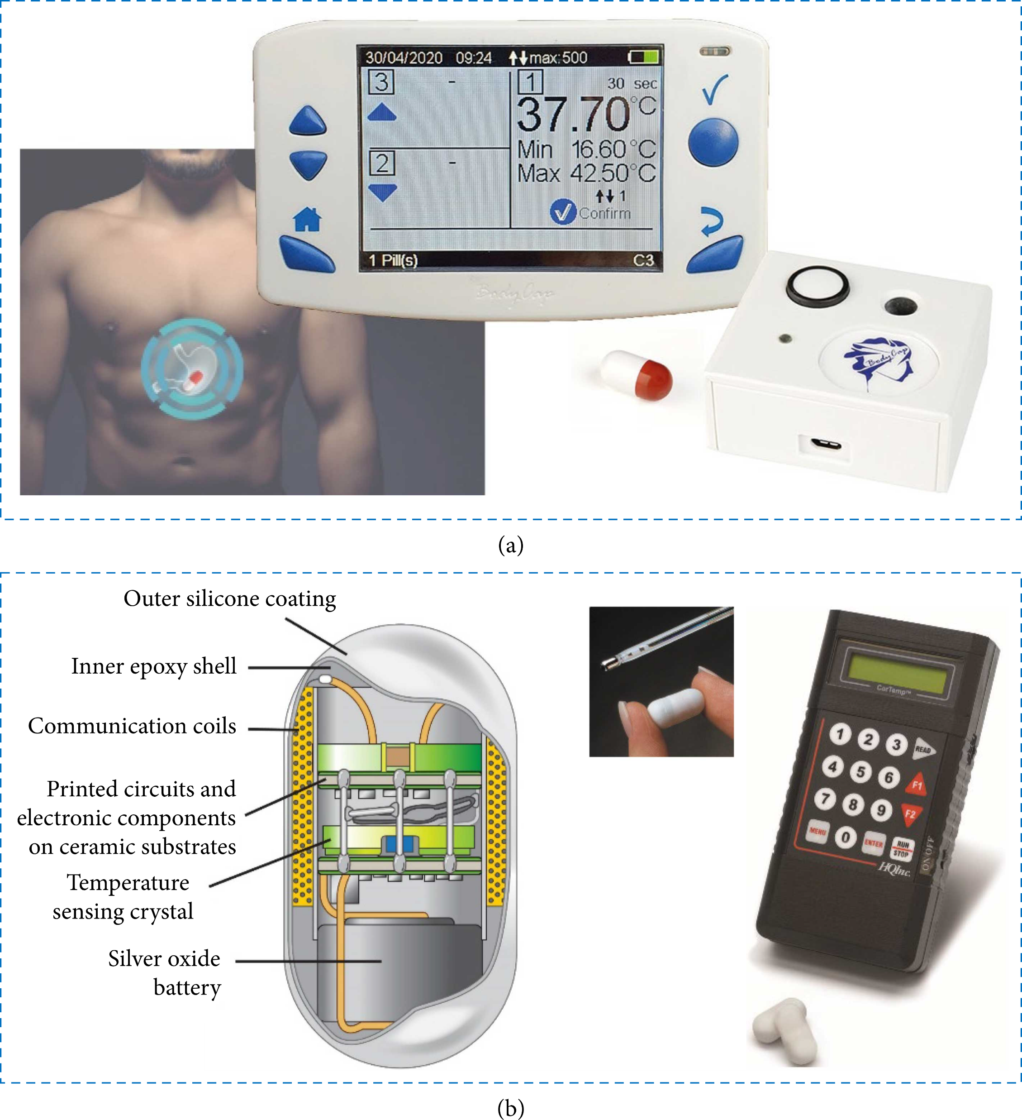
Title: Video Capsule Endoscopy and Ingestible Electronics: Emerging Trends in Sensors, Circuits, Materials, Telemetry, Optics, and Rapid Reading Software
Advanced Devices & Instrumentation, Volume 2021 |Article ID 9854040
https://doi.org/10.34133/2021/9854040
Dylan Miley, Leonardo Bertoncello Machado, Calvin Condo, Albert E. Jergens, Kyoung-Jin Yoon, and Santosh Pandey

Slide 4
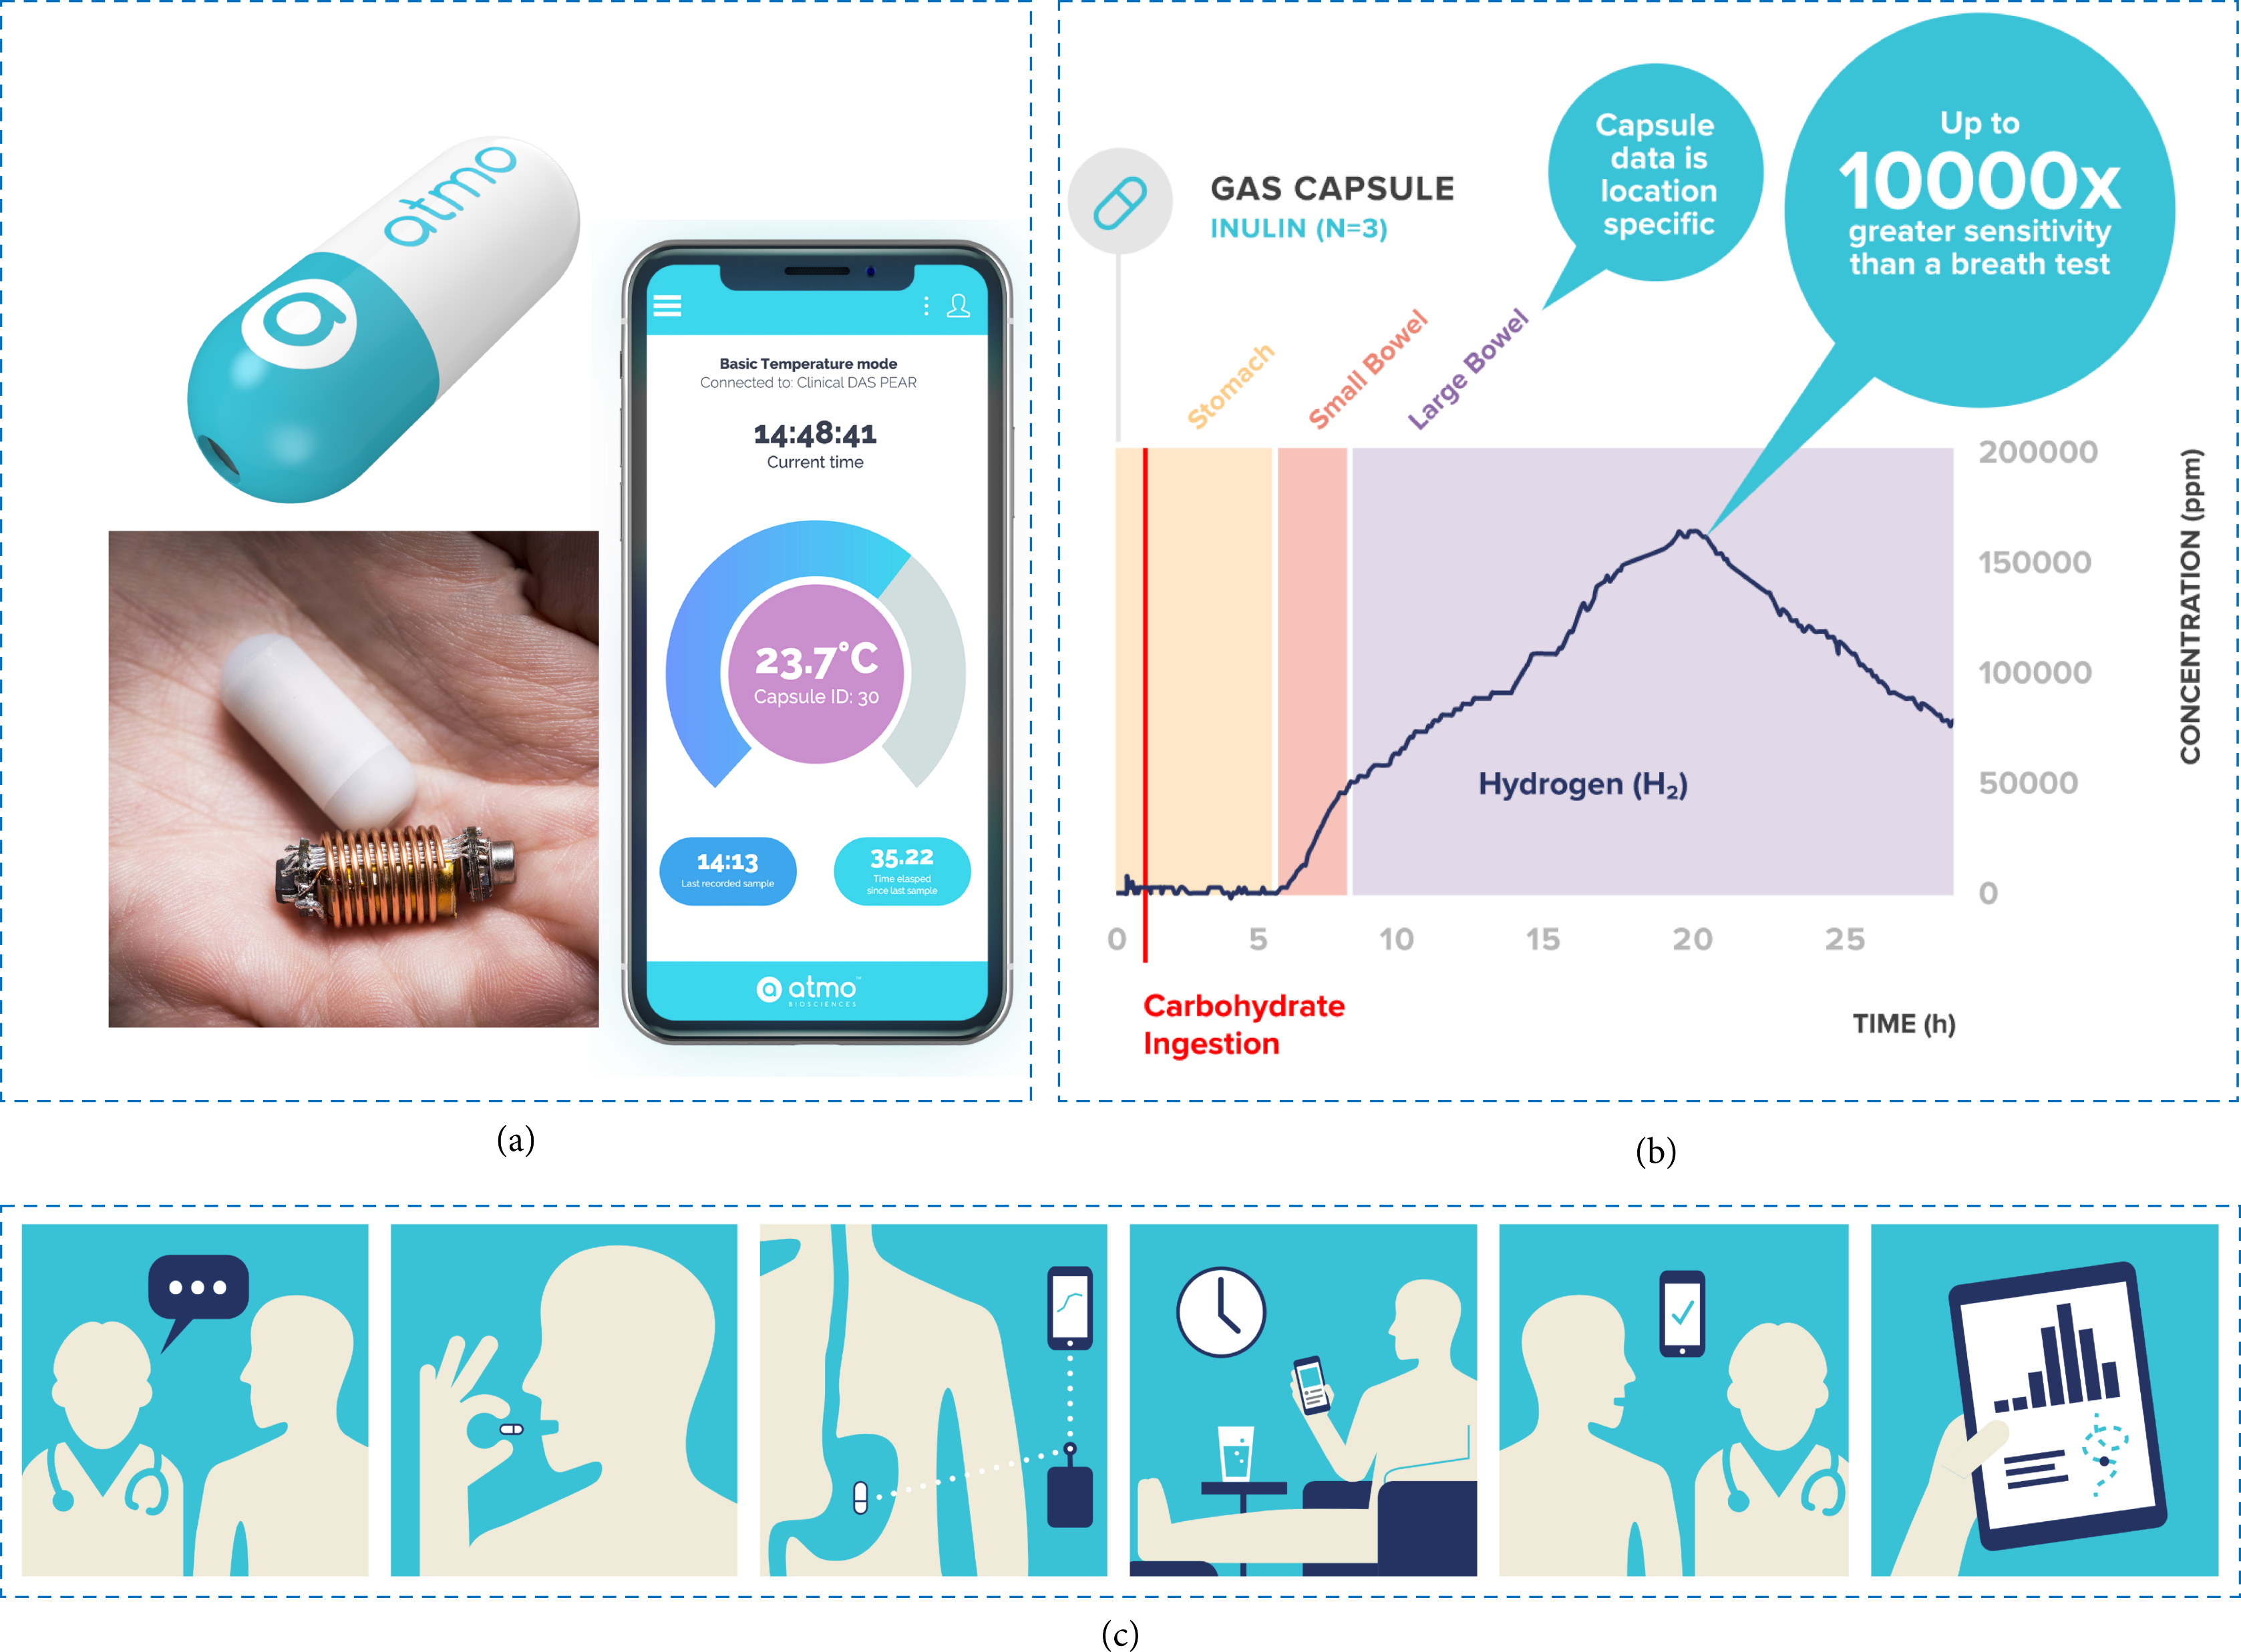
Title: Video Capsule Endoscopy and Ingestible Electronics: Emerging Trends in Sensors, Circuits, Materials, Telemetry, Optics, and Rapid Reading Software
Advanced Devices & Instrumentation, Volume 2021 |Article ID 9854040
https://doi.org/10.34133/2021/9854040
Dylan Miley, Leonardo Bertoncello Machado, Calvin Condo, Albert E. Jergens, Kyoung-Jin Yoon, and Santosh Pandey

Slide 5
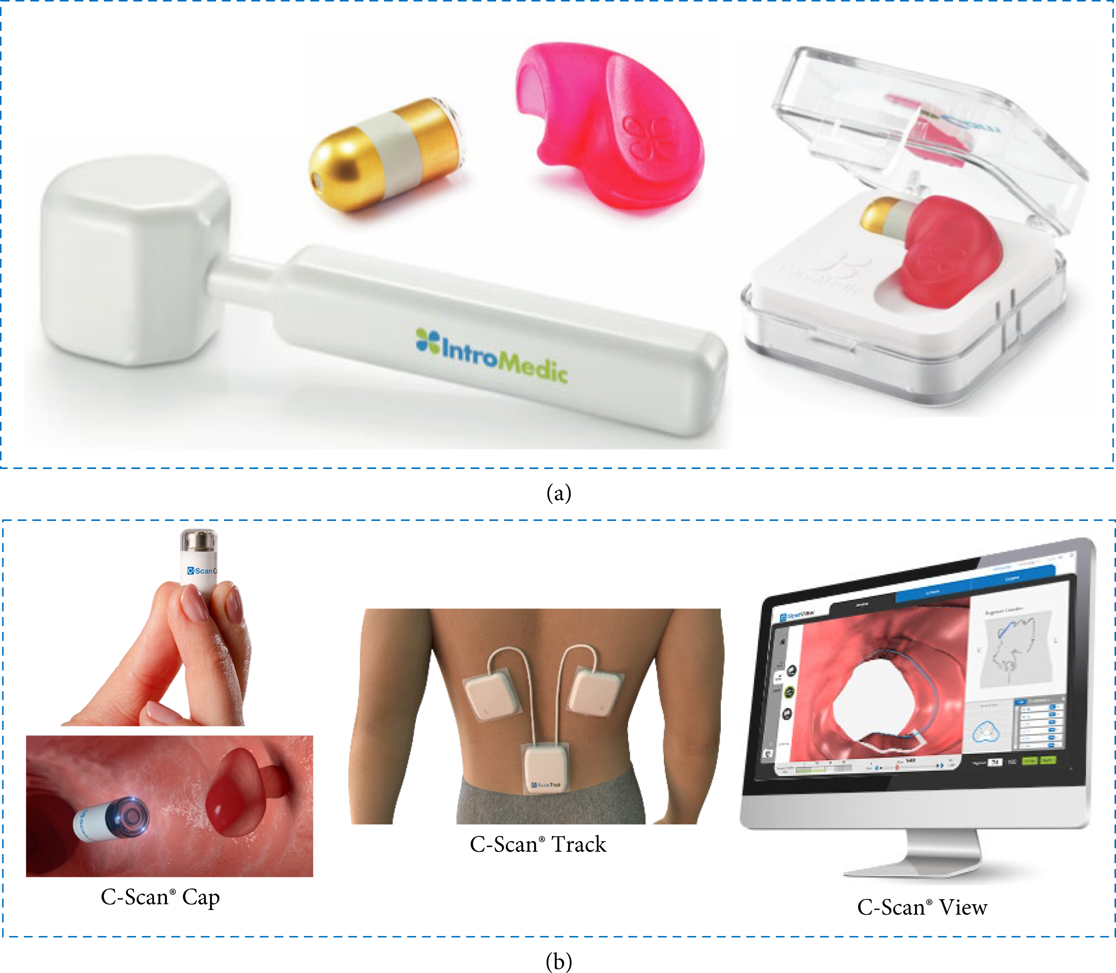
Title: Video Capsule Endoscopy and Ingestible Electronics: Emerging Trends in Sensors, Circuits, Materials, Telemetry, Optics, and Rapid Reading Software
Advanced Devices & Instrumentation, Volume 2021 |Article ID 9854040
https://doi.org/10.34133/2021/9854040
Dylan Miley, Leonardo Bertoncello Machado, Calvin Condo, Albert E. Jergens, Kyoung-Jin Yoon, and Santosh Pandey

Slide 6
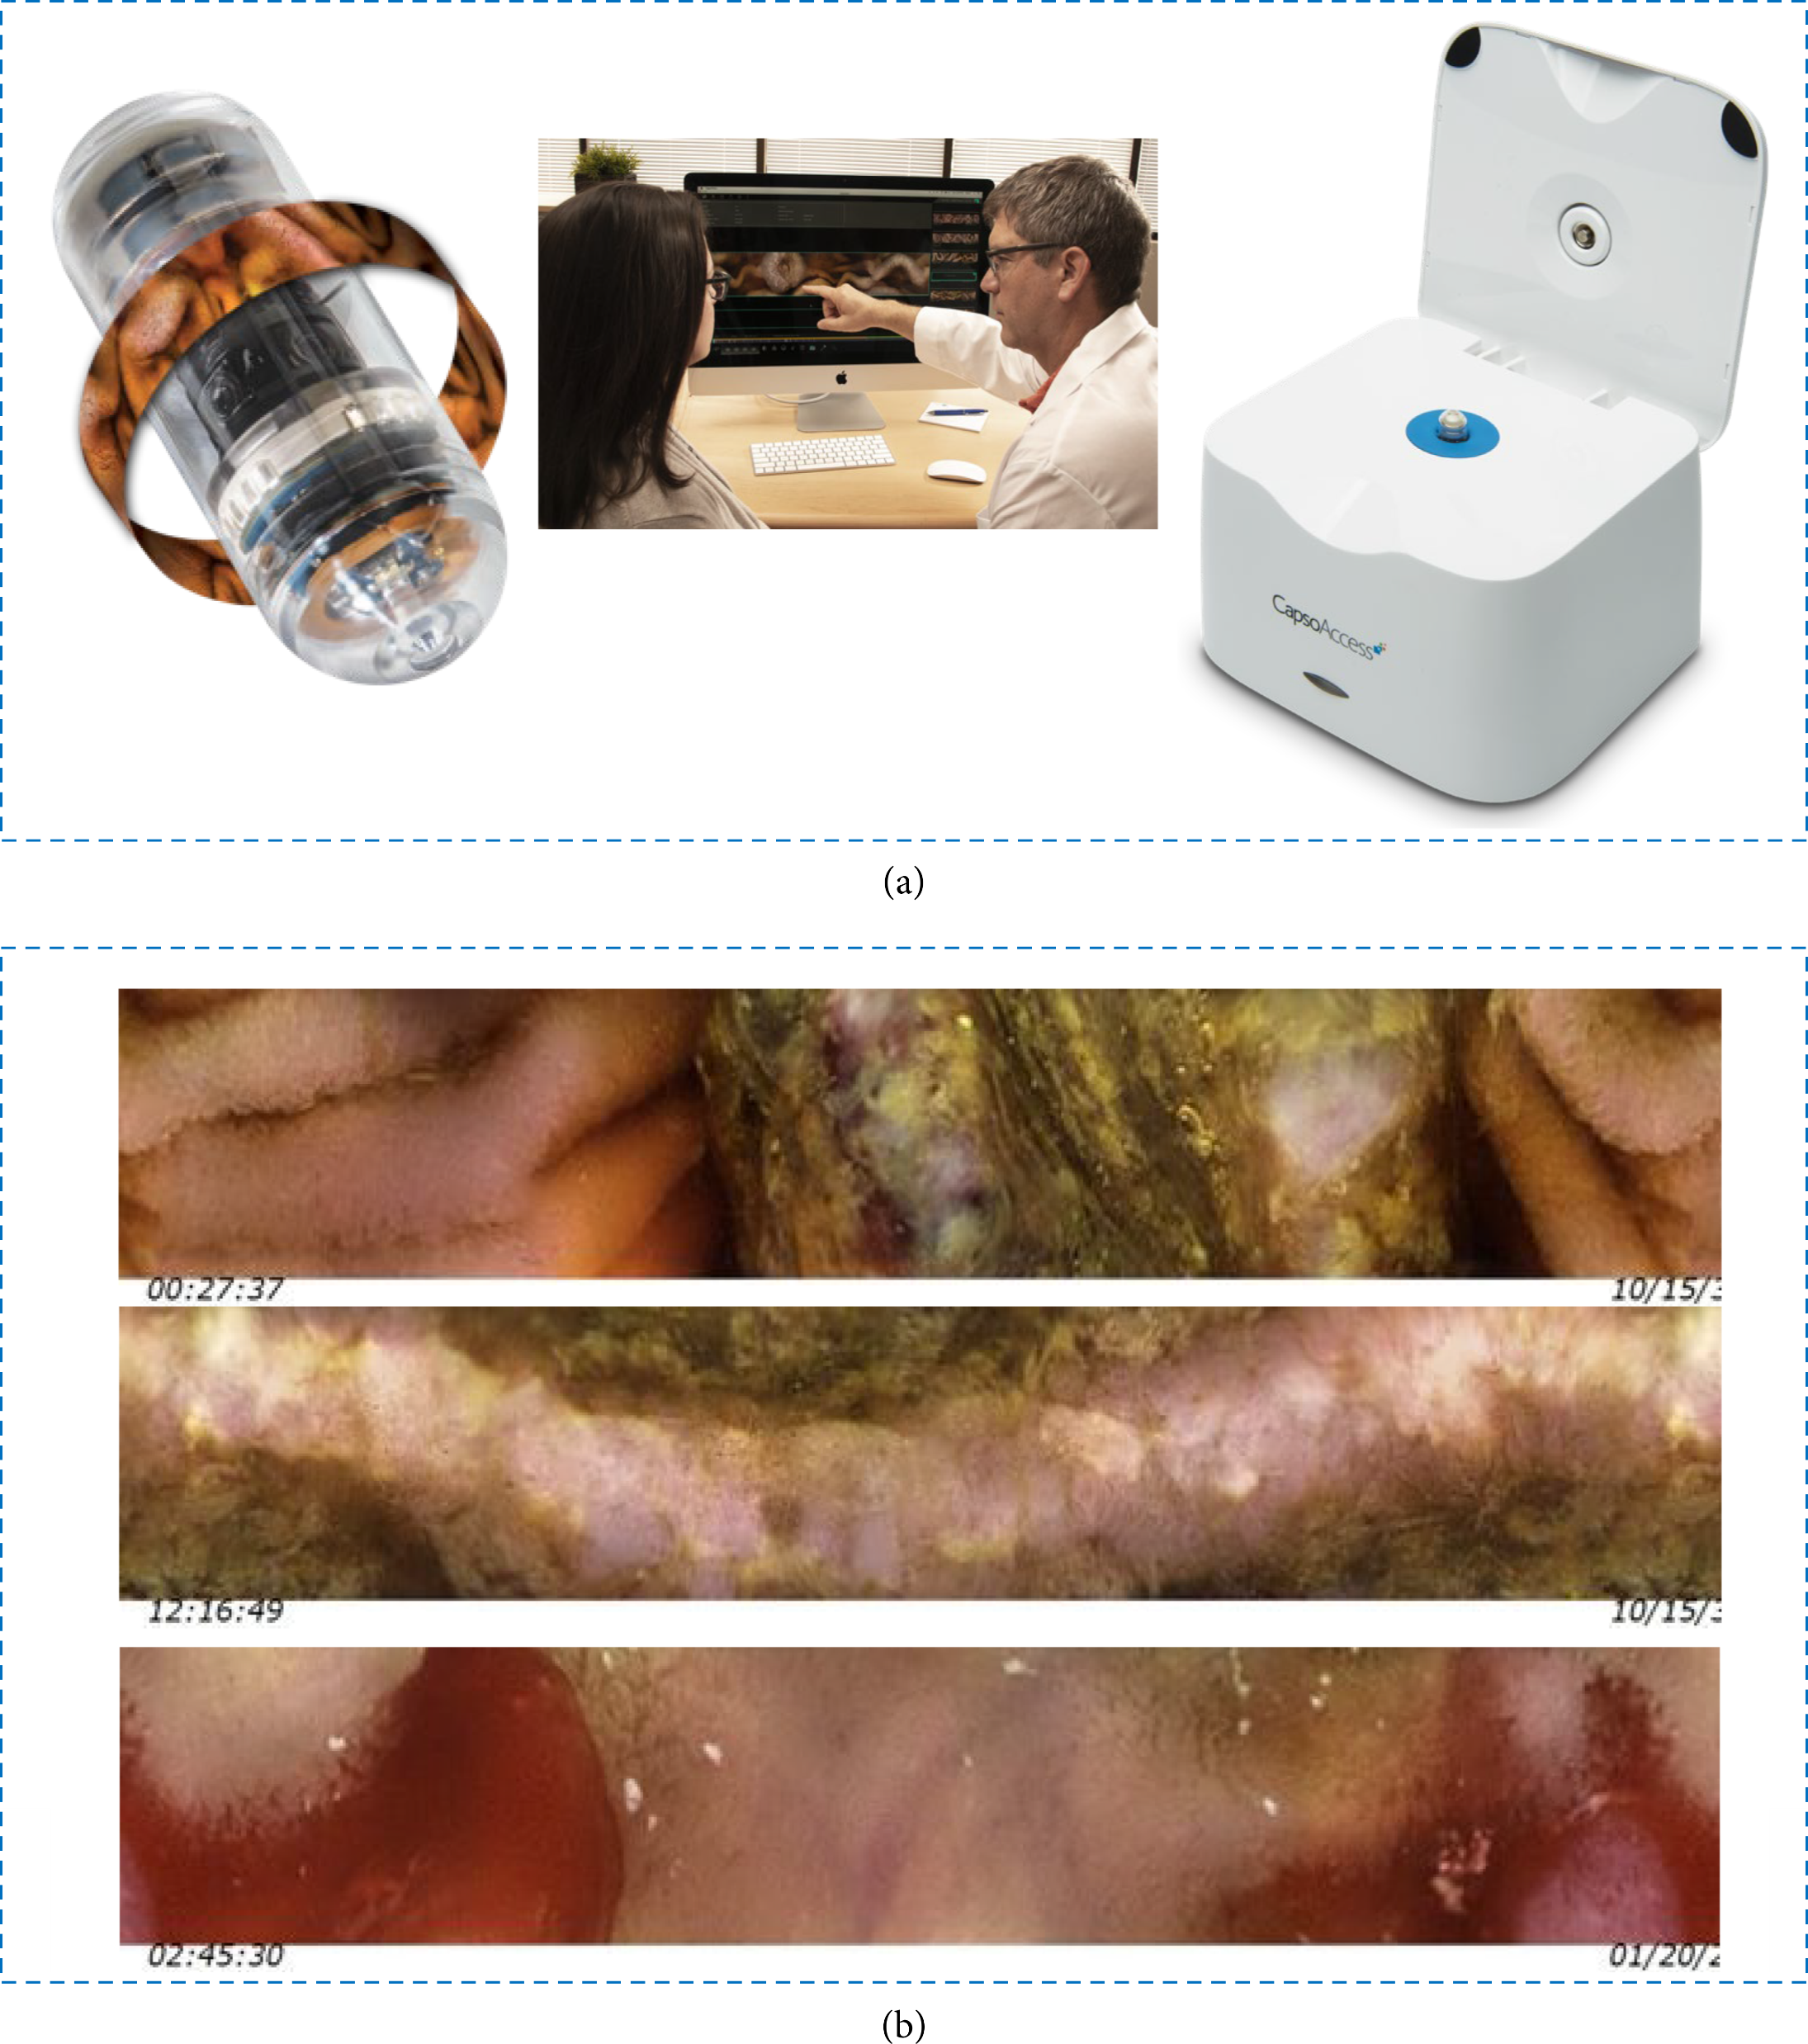
Title: Video Capsule Endoscopy and Ingestible Electronics: Emerging Trends in Sensors, Circuits, Materials, Telemetry, Optics, and Rapid Reading Software
Advanced Devices & Instrumentation, Volume 2021 |Article ID 9854040
https://doi.org/10.34133/2021/9854040
Dylan Miley, Leonardo Bertoncello Machado, Calvin Condo, Albert E. Jergens, Kyoung-Jin Yoon, and Santosh Pandey

